Slide 1
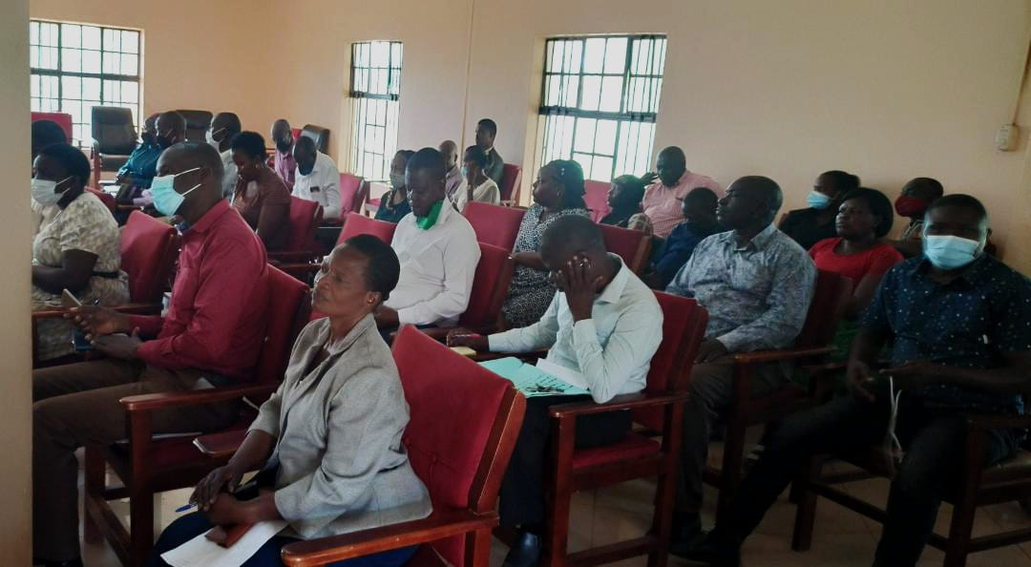
ROLL OUT OF HUMAN CAPITAL MANAGEMENT SYSTEM IN JINJA DLG

Slide 2
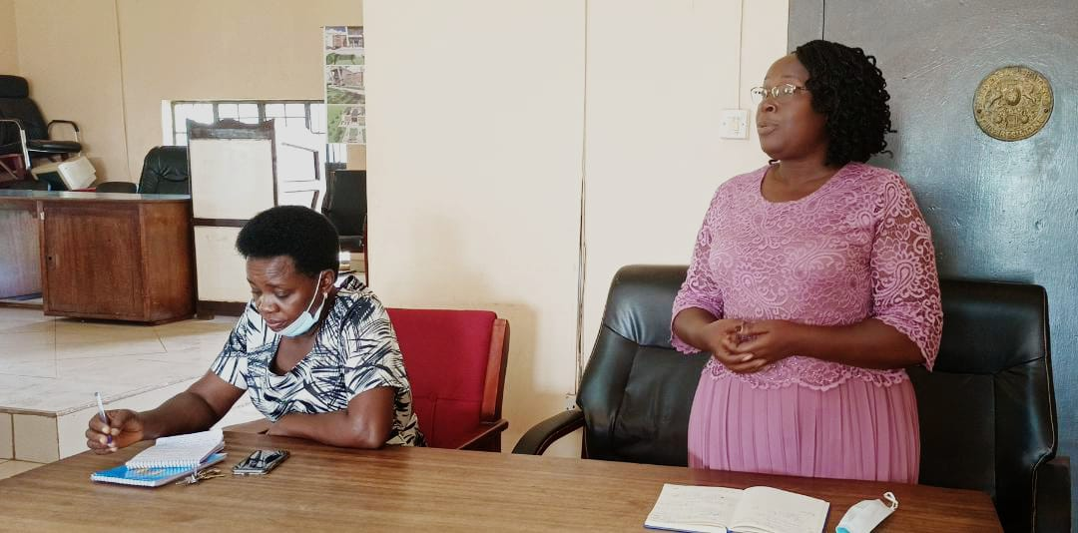
CAO- Jinja DLG Madam Nakamatte Lilian giving opening remarks during HCM Training of staffs

