Slide 1
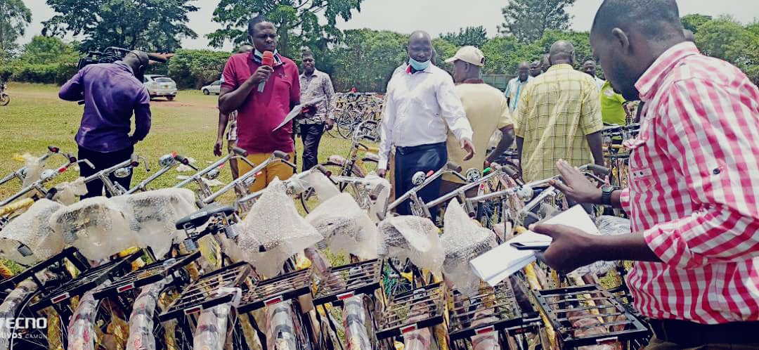
Distribution of Bicycles to LC I and LC11 Chairpersons of Jinja District at Kagoma Primary School

Slide 2
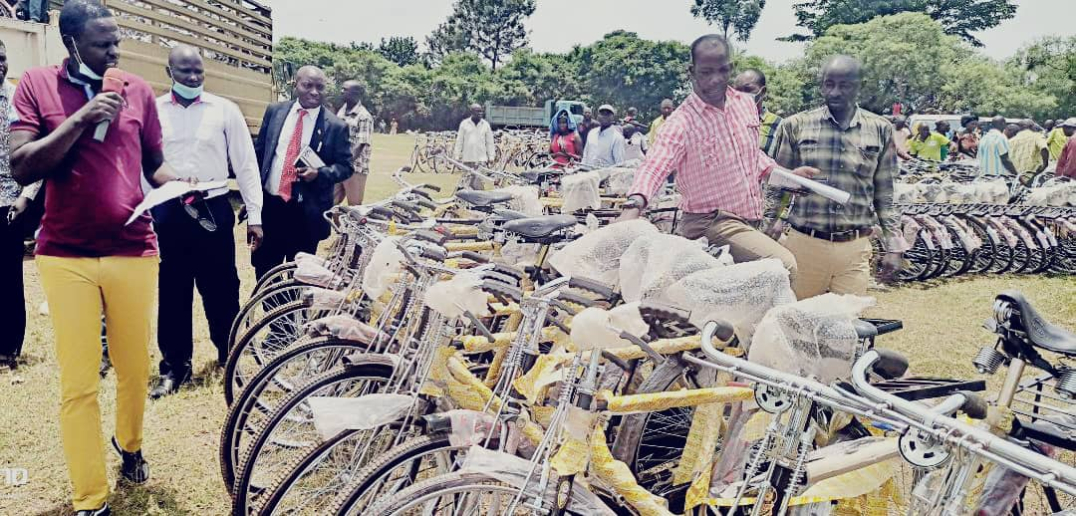
Subcounty Chief Buwenge counting the bicycles delivered for distribution to Lc I and II Chairpersons

